Slide 1
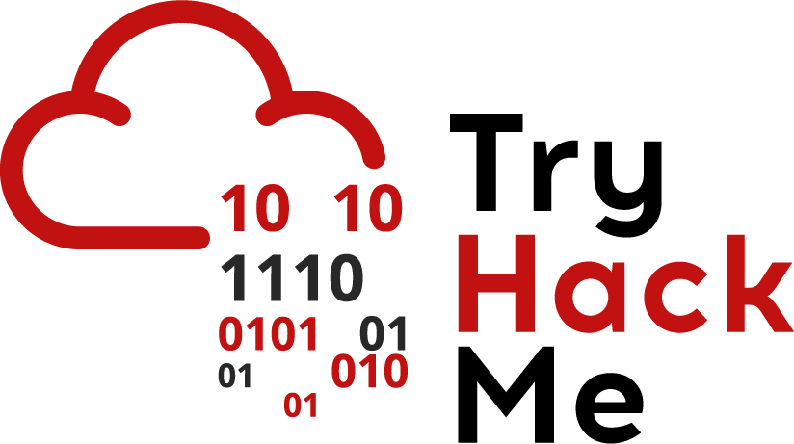
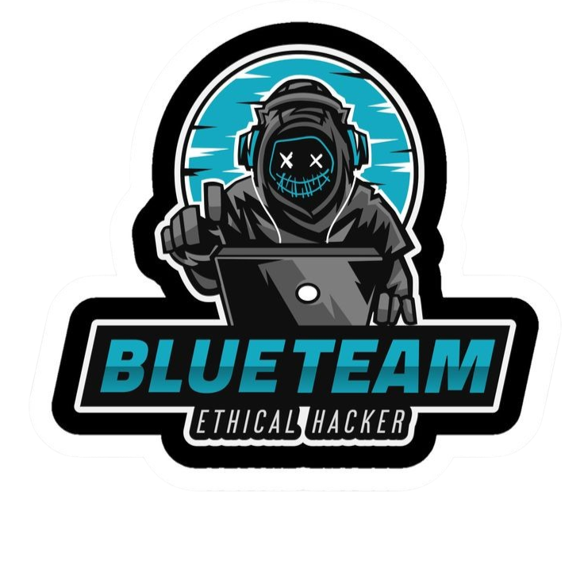

Cyber Kill Chain
Eng. Mahmoud Hassan

Slide 2
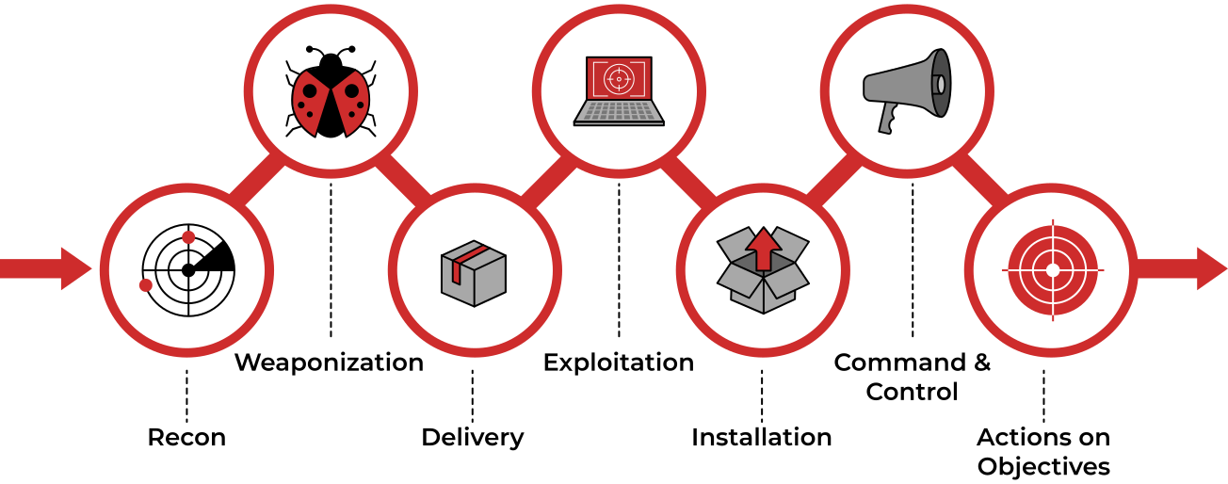
Cyber Kill Chain

Slide 3

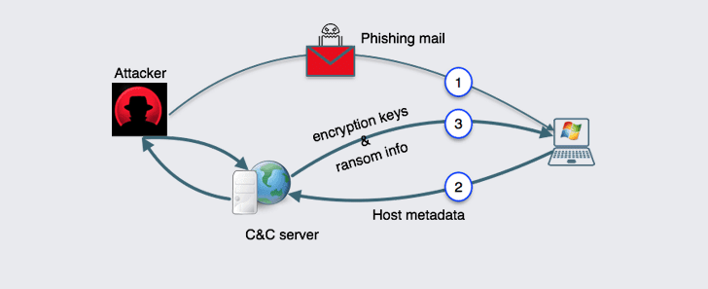
Command & Control (C2)
The Command and Control (C2) Phase:
After achieving persistence and executing malware on the victim’s machine, the attacker opens a communication channel called C2 (Command and Control). This channel allows the attacker to remotely control the victim’s device and manage malicious activities.

Slide 4
Command & Control (C2)
How is a C2 Channel Established?
1. The Compromised Victim’s Device: Communicates with an external server set up by the attacker.
2. Establishing the Connection: Once the connection is established, the attacker gains full control of the victim’s device.
3. Remote Control: The attacker can send commands to the malware on the victim’s device, such as stealing data or downloading additional malicious programs.
Important Note:
The C2 server can be owned by the attacker themselves or by another compromised device.
Example:
The attacker may use a compromised server in another country to hide their identity.

Slide 5
Command & Control (C2)
Most Common C2 Channels Used Today:
HTTP/HTTPS Protocols:
HTTP on port 80 and HTTPS on port 443.
Malicious traffic is blended with legitimate traffic (e.g., web browsing), helping the attacker evade firewalls.
Example:
The communication may appear as a normal website request, but it is actually communicating with a C2 server.
2. DNS (Domain Name System) Protocol:
A technique known as DNS Tunneling.
The infected device sends repeated DNS requests to a DNS server controlled by the attacker.
Example:
It may seem like the device is trying to resolve a normal domain name, but it is actually communicating with a C2 server.

Slide 6



Thank you
+201116735630
mahmoudhassan2947@gmail.com
www.linkedin.com/in/mahmoud-hassan-b4400b1b7

